Slide 1
BD Simulation End Term Evaluation
Mentor: Diya Singhal
Mentee: Anshul Mehta

Slide 2
Assignment 1 report
Aim of the first assignment is to plot the graph of velocity vs time with the information given and find the terminal velocity of the sphere free falling in the fluid. Software used for the purpose is MATLAB.
A particle freely falling in the fluid is acted by gravitational force downwards, bouncy upwards and a drag force which acts opposite to the direction of velocity of the particle. Drag force is proportional to the velocity, radius and viscosity of the fluid. So, equation of rate of change of velocity of sphere falling downwards can be written as:
mdu/dt=mg-⍴Vg-6πrηu
m=mass of sphere
u=velocity of sphere
g=gravitational acceleration
⍴=density of fluid
V=volume of sphere
r=radius of sphere
η=viscosity of the fluid

Slide 3
Solving the differential equation would give the analytical expression and to get the analytical answer, boundary condition u(t=0)=0 can be used. Analytical expression:
u(t)=mg/(6πrη)*(1-⍴V/m)*[1-e^(6πrηt/m)]
Numerical method is used to solve differential equations with the help of regression and approximation so as to skip the part of integration.
du/dt≃[u(t+Δt)-u(t)]/Δt
Putting this expression in the differential equation would give us the Numerical expression and the same boundary condition of u(t=0)=0 can be used to get the Numerical solution. Numerical solution:
u(t+Δt)=gΔt(1-⍴V/m) +u (t)[ 1+6πrηΔt/m ]
u(Δt)=gΔt(1-⍴V/m) +u (0)[ 1+6πrηΔt/m ]
u(2Δt)=gΔt(1-⍴V/m) +u (Δt)[ 1+6πrηΔt/m ]
.
.
.
u(nΔt)=gΔt(1-⍴V/m) +u ((n-1)Δt)[ 1+6πrηΔt/m]
Initial values used (in S.I. units)
Radius of sphere=10^-5
Density of liquid =1000, of sphere=8050
Viscosity of liquid=0.001
t=0.001 and Δt = 0.0001
g=9.8

Slide 4
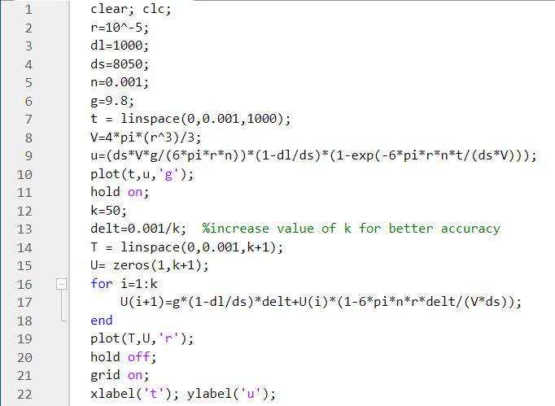
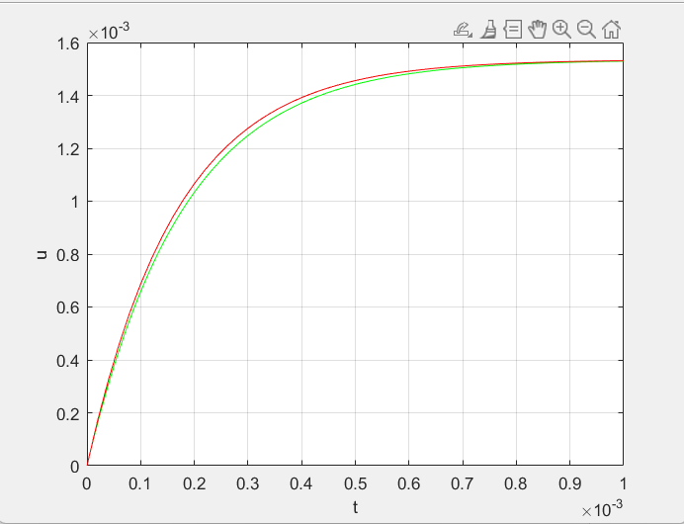
2-8 defining variables and initialization of values
9-10 Defining u, putting its analytical expression and plotting t vs u
12- 15 defining T and U as new variables for t and u. Also, k is the number of iterations to be performed.
16-19 defining and plotting numerical expression.

Slide 5
Assignment 2 report
Aim of the second assignment is to plot the trajectory of the Brownian particle and find the diffusivity.
Software used for the purpose is MATLAB.
A particle of size in the range of few micrometers travelling in the fluid is acted by gravitational force downwards, bouncy upwards and a drag force which acts opposite to the direction of velocity of the particle and Brownian force. Since the dimensions of particle is very small, gravity and bouncy can be neglected and domination forces comes out to be drag force and Brownian forces.
Drag force acting on a particle (F_{drag} )
F_{drag}=-ζ dr /dt
Variable of interest:
r =r vector
t= time
Brownian force acting on a particle (F_{B})
F_{B}= sqrt(6kB Tζ/Δt)n
Variables of interest:
n_{i}= random unit vector pointing in range [-1,1]
Δt=change in time

Slide 6
Balancing both the forces
F_{drag}+ F_{B}=ma=0
-ζ dr /dt+sqrt(6kB Tζ/Δt)n =0
Non dimensional equation for the above equation is
dr*/dt*=sqrt(6/ Δt*)n*
r*=r/R, r is the position vector and n is random vector, both can be written in x, y, z variables
t*=t k_{B}T/(ζ R²)
=tD_{SE}/R², where D_{SE}=Stokes-Einstein diffusivity
The above differential equation can be solved from the numerical solution of differential equation
r*(t*+ Δt*)=r*(t*)+sqrt(6 Δt*)n*
x*(t*+ Δt*)=x*(t*)+sqrt(6 Δt*)n_{x}*
y*(t*+ Δt*)=y*(t*)+sqrt(6 Δt*)n_{y}*
z*(t*+ Δt*)=z*(t*)+sqrt(6 Δt*)n_{z}*
Initial values used:
At t*=0, r*=(0,0,0)
Δt*=0.001, t*=100 total 10^5 iterations

Slide 7
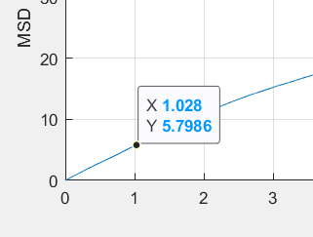
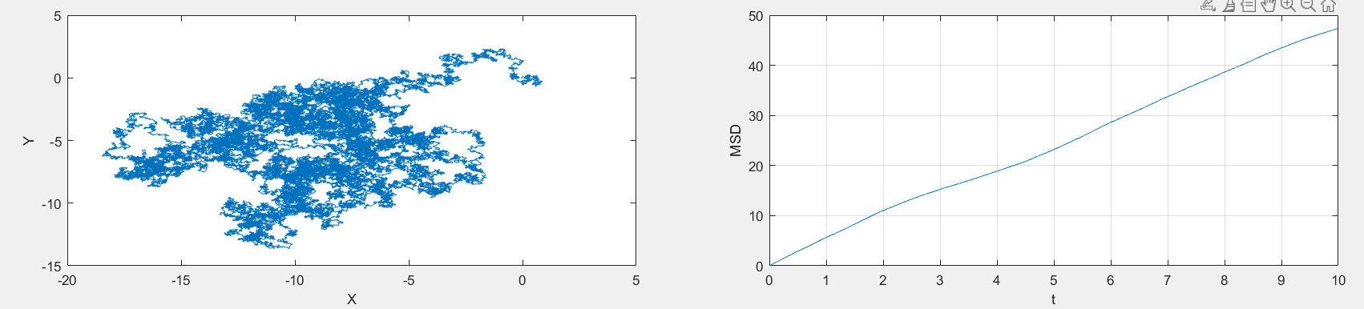
Mean Square Displacement (MSD) :
For N number of input, code for msd is:
for i=1:N
for j=1:N-i+1
msd(i+1)=( (X(j+i)-X(j))^2 + (Y(j+i)-Y(j))^2 + (Z(j+i)-Z(j))^2 )/(N+1-i)+msd(i+1);
end
end
MSD(1) for the code written in MATLAB comes out to be in a range of (0.9-1.1)
MSD(1) can be calculated by finding the slope of t vs MSD graph at t=0

Slide 8
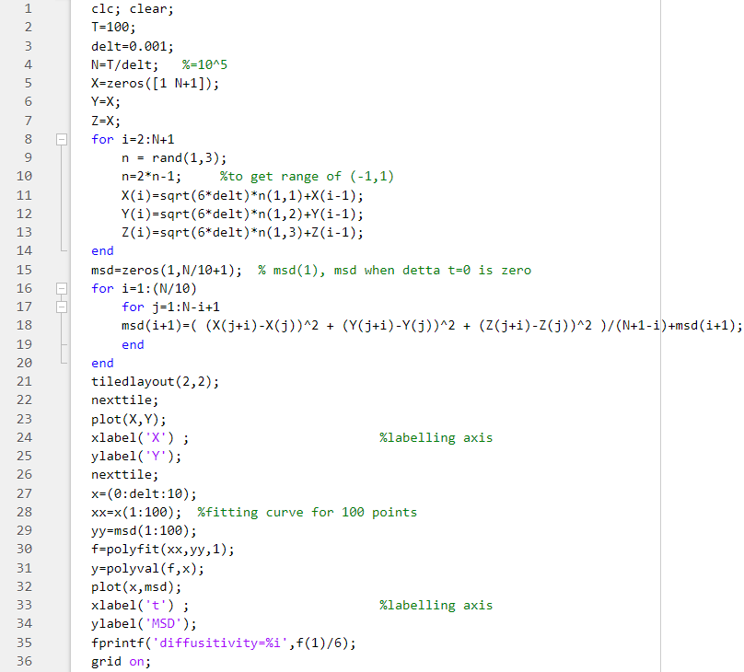

Slide 9
Assignment 3 report
Aim of third assignment is the understand the bead-spring model of single polymer chain and plot the graph of non dimensionalized R(distance between two beads) vs t(time). Software used is MATLAB.
A polymer chain consists of thousands of beads which can be simplified as N+1 beads connected by N springs. Beads experience certain forces which can be balanced. The forces experienced are drag force, Brownian force and spring force. Other forces can be neglected.
Spring force
F_{sp,1}= (k_{B}T/vb_{K}²)((3-ṙ^2)/(1-ṙ^2))R
F_{sp,2}=- (k_{B}T/vb_{K}²)((3-ṙ^2)/(1-ṙ^2))R
v= number of Kuhn lengths mimicked by one spring
b_{K}=Kuhn length of the polymer chain
r =r vector
R=r₂-r₁
ṙ=|R|/(vb_{K})

Slide 10
2)Drag force on each bead (F_{drag,i})
F_{drag,i}=-ζ dr_{i}/dt
3)Brownian force on each bead (F_{B,i} )
F_{B,i} = sqrt(6k_{B}Tζ/Δt)n_{i}
n = n vector, random vector with values in range [-1,1]
Balancing force (for i=1,2)
0= F_{drag,i} + F_{B,i +} F_{sp,I}
ζ dr_{i}/dt=sqrt(6k_{B}Tζ/Δt)n_{i}+ F_{sp,i}
Non dimensionlizing r, t & F
r*=r/b_{K} t*=t (k_{B}T)/(ζb_{K}²) F*=Fb_{K}/(k_{B}T)

Slide 11
New dimensionless version of equation:
dr₁*/dt*=sqrt(6/ Δt*)n₁+(3-ṙ^2)/(v(1-ṙ^2))R*
dr₂*/dt*=sqrt(6/Δt*)n₂₋ (3-ṙ^2)/(v(1-ṙ^2))R*
Approximating differential equation by numerical method and we can get the equations to be iterated on MATLAB.
r₁*(t*+ Δt*)=r₁*(t*)+sqrt(6 Δt*)n₁* + (3-ṙ^2)/(v(1-ṙ^2))R* Δt*
r₂*(t*+ Δt*)=r₂*(t*)+sqrt(6 Δt*)n₂* - (3-ṙ^2)/(v(1-ṙ^2))R* Δt*
Initial condition used are v=500
At t=0, r₁*=[0 0 0]^{T} and r₂*=[ sqrt(v) 0 0]^{T} Total time t*=10^4 and Δt*=0.001
Result: rms of R*≈ 21±1

Slide 12
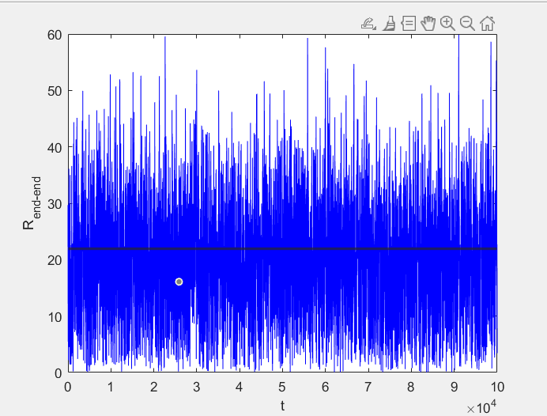

Slide 13
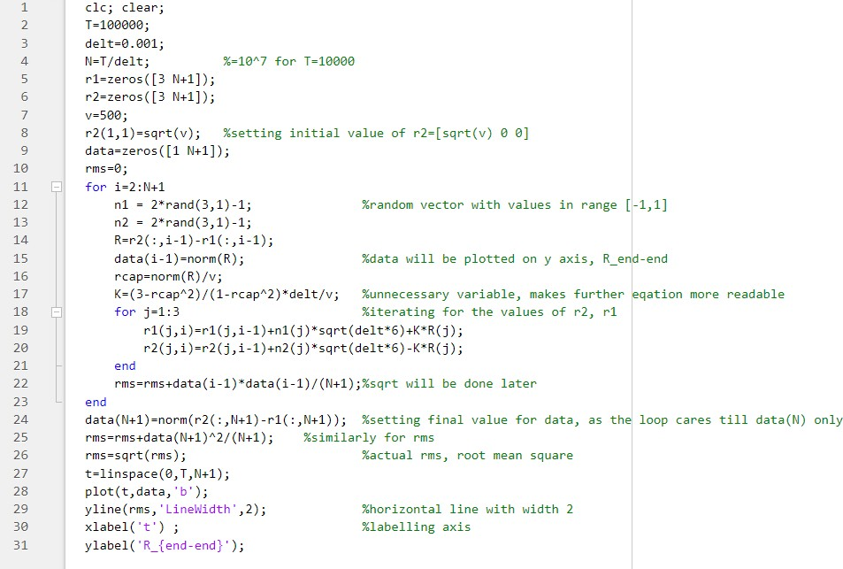

Slide 14
Concepts Learned from this Project
1)Drag force
2)Analytical solution
3)Numerical solution
4)Non-dimensional equations
5)Brownian force on the particle
6)Bead-Spring Model of single polymer chain
7)Spring force on a molecular spring

Slide 15
THANK YOU

